Slide 1
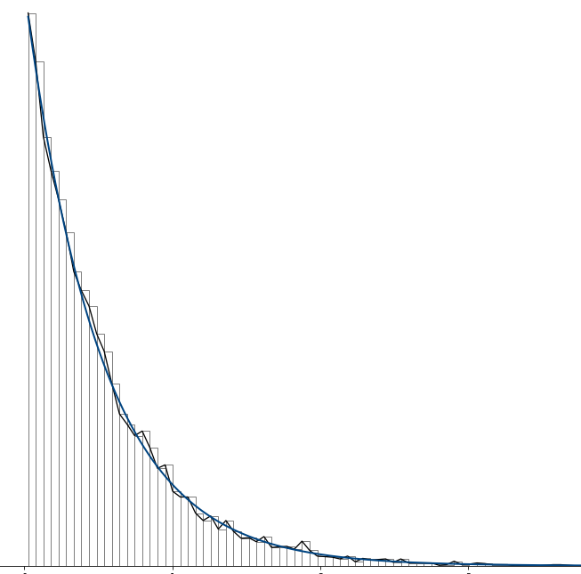
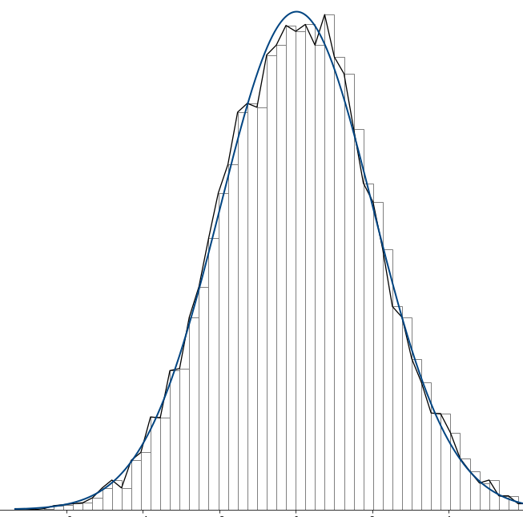

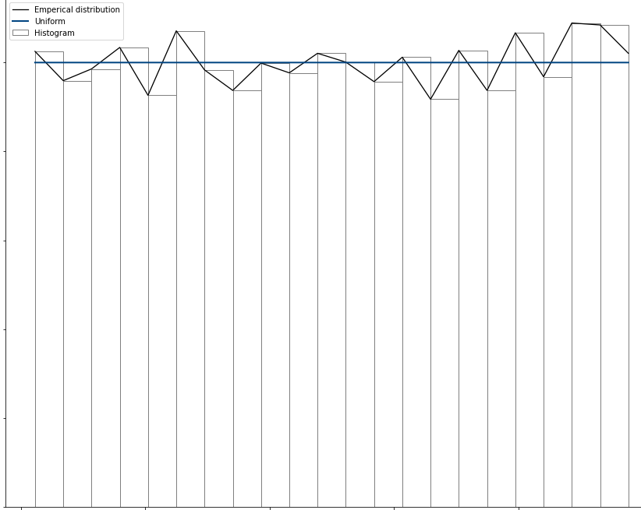
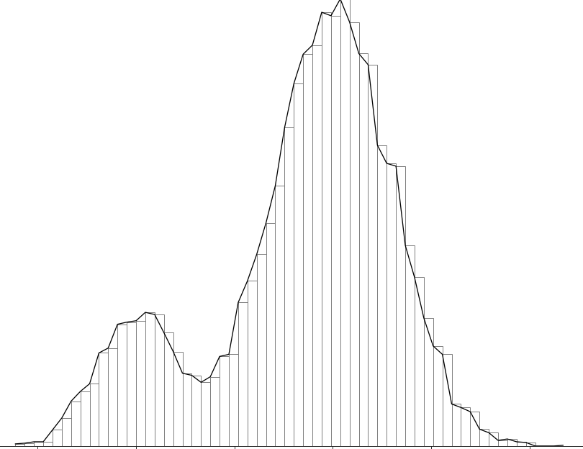

99.9%
99.9%
N (µ, σ)
99.5%
distfit
A Python Library for Probability Density Fitting
$${\left(x+a\right)}^{n}=\sum_{k=0}^{n}{\left({n \atop k}\right)x^{k}a^{n−k}}$$
µ1 - µ2
PMF
PDF 1
PDF 2

